Slide 1
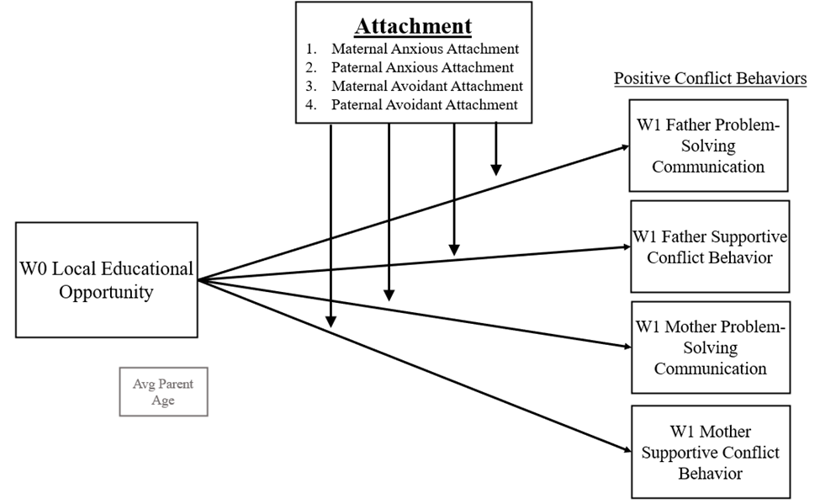
Positive Functioning in African American Families: Maternal and Paternal Romantic Attachment as Moderators of Associations between Local Educational Opportunity and Positive Interparental Conflict
Aaliyah Dorsey, Emefa Amoah, B.S., Hannah Swerbenski, B.S., Melissa Sturge-Apple, Ph.D., & Patrick Davies, Ph.D.
Department of Psychology, University of Rochester, Rochester, NY
Introduction:
Methods:
Moderation Results:
Examining the influence of romantic attachment as a moderator of local educational opportunity and its impact on positive interparental conflict within African American families yields insights into contextual influences on family dynamics. It allows for culturally tailored interventions, targeted strategies for promoting healthy relationships and addressing disparities through an equity lens. This research contributes to a more inclusive understanding of family dynamics.
- Local Neighborhood Educational Opportunities - encompasses the various educational options that are easily accessible and cater to the needs of the population.
- Moderation - investigates how the relationship between two variables varies depending on the presence of a third variable, known as a “moderator.”
​​-Adult Romantic Attachment - refers to patterns of emotional and relational behavior that adults exhibit in their close relationships, which shape how individuals form and maintain relationships throughout their lives.
Anxious attachment- a dimension of relationship insecurity that is denoted by the degree of worry of abandonment and or rejection.
Avoidant attachment- another dimension of relationship insecurity characterized by the degree to which the individual limits emotional closeness based on the belief that partners cannot be trusted to provide loving care, leading them to defensively avoid dependence and suppress their attachment needs.
- Interparental Conflict - denotes the occurrence of discord, disagreement, or confrontations between parental figures or caregivers within the familial or caregiving context.
Participants:
-66 families (mothers, fathers, and their 3-year-old child) were recruited through school districts, online family forums, and flyers posted at local sites frequented by families.
-To be included in the present analyses, either mothers, fathers, or both self-identified as Black or African American
Measures:
-Child Opportunity Index 2.0 (COI 2.0): Geocoding was used to link family addresses to nationally-normed census-tract level data from the COI 2.0, including the local educational opportunity for the year of 2015, which corresponds to approximately 1.5 years prior to W1. The composite local educational opportunity consists of 11 component indicators, such as high school graduation rate, school poverty, and preschool enrollment rates.
-Experiences in Close Relationships-Revised (ECR-R; Fraley et al., 2000): Mothers and fathers self-reported their attachment anxiety and avoidance at W1.
-Interparental Problem-Solving Task (IPST): W1 problem-solving communication and supportive conflict behaviors for mothers and fathers were observationally coded during the IPST, which asks parents to resolve two issues in their relationship through a verbal discussion. Codes were drawn from the System for Coding Interactions in Dyads (SCID; Malik & Lindahl, 2004; ICCs = 652-.779).
Maternal Avoidant Attachment: Main effects. Higher maternal avoidant attachment was associated with less positive conflict behaviors (ps = .001-.007), whereas educational opportunity was associated with increased supportive conflict behaviors (ps = .001-.057). Moderation. Maternal avoidant attachment scores significantly moderated the association between educational opportunity and paternal supportive communication (β = -.274, p = .008).
Maternal Anxious Attachment: Main effects. Maternal anxious attachment was associated with less positive conflict behaviors in mothers (ps <.001) and fathers (ps = .019-.037). Educational opportunity was positively associated with problem-solving communication (ps = .001) but not supportive conflict behavior (ps > .103). Moderation. There was no significant moderation by maternal anxious attachment, and thus no interactions were probed further.
Paternal Avoidant Attachment: Main effects. Paternal avoidant attachment was associated with less positive conflict behaviors in fathers (ps <.001) but not mothers (ps >.161). Educational opportunity was positively associated with positive conflict behaviors (ps .001-.031) except paternal supportive conflict behavior. Moderation. Finally, paternal anxious attachment scores significantly moderated the association between educational opportunity and maternal supportive conflict behavior (β = -.225, p = .002), as well as paternal supportive conflict behavior (β = -.228, p = .005).
Key Concepts:
Paternal Anxious Attachment: Main effects. Higher paternal anxious attachment was associated with less positive conflict behaviors (ps = .001-.005), with the exception of paternal problem-solving communication (p = .083). Local educational opportunity was not significantly associated with either mothers or fathers positive conflict behavior (ps > .131). Moderation. Paternal anxious attachment scores significantly moderated the association between educational opportunity and paternal supportive communication (β = -.384, p = .020).
Conceptual Model:
Discussion:
Summary: Local educational opportunity was positively associated with positive conflict behaviors, whereas insecure romantic attachment was generally associated with fewer positive conflict behaviors. In several cases, parent attachment moderated associations between educational opportunity and supportive conflict behaviors, such that benefits associated with local educational opportunity were ameliorated in families with insecurely attached parents.
Interpretation & Explanation: For securely attached parents, local educational opportunity may be a meaningful environmental protective factor. Alternatively, parents with insecure attachments may not benefit from these opportunities due to more proximal, family-level issues. In some cases, such as paternal anxious attachment, feelings of inadequacy may be exacerbated through self-comparison to other families in neighborhoods with increased opportunity.
Implications: For individuals with insecure attachment styles seeking to improve dyadic interparental conflict resolution skills, it is recommended to enhance self-awareness of attachment styles, improve communication through active listening and expressing needs, develop emotional regulation techniques, foster secure attachment behaviors, practice conflict resolution techniques like problem-solving and compromise, and cultivate a positive relationship climate through appreciation and shared goals. Patience, understanding, and commitment to growth are key in this process.
References
DiversityDataKids. (2023). “Child Opportunity Index 2.0 database”, retrieved from https://data.diversitydatakids.org/dataset/coi20-child-opportunity-index-2-0-database?_external=True on Jul 07, 2023.
Fraley, R. C., Waller, N. G., & Brennan, K. A. (2000). An item-response theory analysis of self-report measures of adult attachment. Journal of Personality and Social Psychology, 78, 350-365.
Malik, N. M., & Lindahl, K. M. (2004). System for coding interactions in dyads (SCID). In Couple Observational Coding Systems (pp. 173-189). Routledge Taylor & Francis Group. https://doi.org/10.4324/9781410610843
Overall, N. C., Fletcher, G. J. O., Simpson, J. A., & Fillo, J. (2015). Attachment insecurity, biased perceptions of romantic partners’ negative emotions, and hostile relationship behavior. Journal of Personality and Social Psychology, 108(5), 730–749. https://doi.org/10.1037/a0038987
Sturge-Apple, M. L., Davies, P. T., & Cummings, E. M. (2006). Impact of Hostility and Withdrawal in Interparental Conflict on Parental Emotional Unavailability and Children's Adjustment Difficulties. Child Development, 77(6), 1623-1641. https://doi.org/10.1111/j.1467-8624.2006.00963.x

