Slide 1


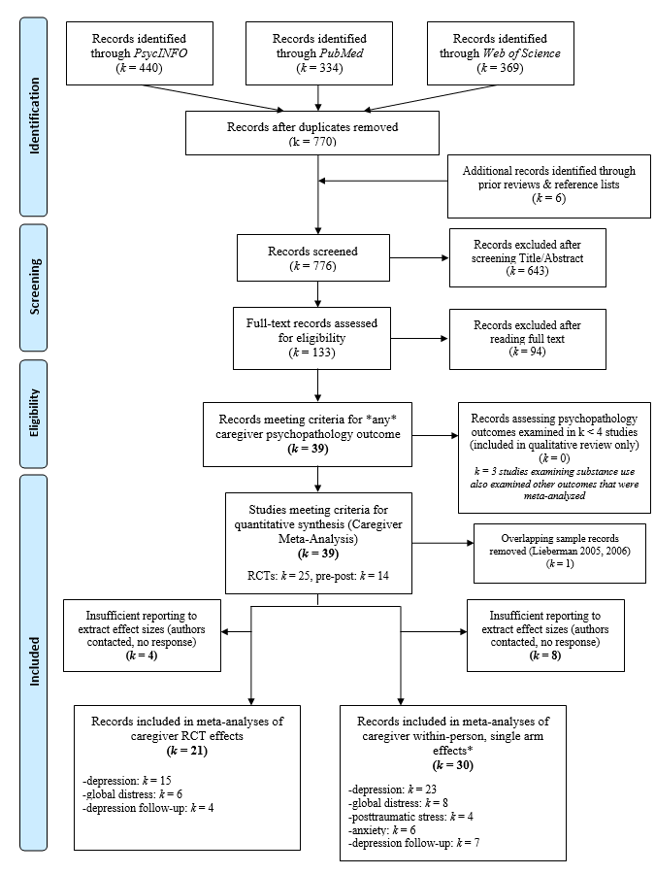
Expanding Treatment Targets: Meta-analysis of Attachment-Based Interventions on Caregiver Psychopathology Outcomes
Hannah Swerbenski, M.A^{.1, 2,} Leena Twal, B.A ¹., Justin Russotti, Ph.D^{.2,} Melissa L. Sturge-Apple, Ph.D ^{1, 2}., Akamewane Ebude ¹, & Sheree Toth, Ph.D. ²
¹ University of Rochester; ² University of Rochester Medical Center/Mt. Hope Family Center
Background
Results
Attachment-based interventions are evidence-based treatments that utilize the principles of Attachment Theory in clinical work with caregivers and children (Ziv, 2005).
Previous reviews have primarily focused on the benefits of attachment-based interventions for parenting and children’s attachment security (e.g., Facompré et al., 2018).
Objective
To characterize the efficacy of attachment-based interventions for reducing caregiver psychopathology by incorporating complementary Family Systems Theory and developmental psychopathology frameworks.
Method
776 records screened from PsycINFO, PubMed, and Web of Science, resulting in 39 studies (Ncg = 3,339, 72 extracted effects) meeting inclusion criteria.
Records were included in the present meta-analysis if they met the following criteria:
  Were written in English
  Conducted with human subjects
  Evaluated attachment-based interventions (including RCTs and within-person change designs) involving both caregiver and child
  Included measures of caregiver psychopathology outcomes
  Assessed changes in caregiver psychopathology due to treatment
  Targeted children aged 6 or younger on average at baseline
  Reported unique effects not found in other identified study records
Meta-Analytic Effects for Caregiver Outcomes
Summary & Discussion
Effect | k | N | Cohen’s d | SE | 95% CI | Q | I² | SM Rel-Prob | Egger’s Z
Within-Person Effects on Caregiver Depression | 23 | 866 | -.821*** | .16 | [-1.133, -.509] | 307.62*** | 96.07 | .96 | -3.99***
Adjusted Within-Person Effects on Caregiver Depression (Outliers Removed) | 21 | 830 | -.654*** | .12 | [-.897, -.411] | 247.80*** | 93.37 | .96 | -2.48*
RCT Designs on Caregiver Depression (Relative to Control) | 15 | 1253 | -.231** | .07 | [-.372, -.089] | 20.76 | 30.81 | .94 | -.198*
Within-Person Effects on Caregiver Global Distress | 8 | 195 | -.668*** | .15 | [-.953, -.383] | 49.18*** | 85.69 | .90 | .28
RCT Designs on Caregiver Global Distress (Relative to Control) | 6 | 373 | -.254 | .20 | [-.638, -.130] | 18.57** | 70.57 | .03 | -2.32*
Adjusted RCT Designs on Caregiver Global Distress (Relative to Control, Outlier Removed) | 5 | 268 | -.408** | .14 | [-.682, -.134] | 4.82 | 22.73 | .86 | -1.06
Within-Person Effects on Caregiver Posttraumatic Stress Symptoms | 4 | 134 | -1.111*** | .36 | [-1.809, -.412] | 52.47*** | 93.06 | .83 | .20
Within-Person Effects on Caregiver Anxiety | 6 | 154 | -.756*** | .33 | [-1.405, -.107] | 53.02*** | 94.79 | .88 | -4.72***
Adjusted Within-Person Effects on Caregiver Anxiety (Outlier Removed) | 5 | 148 | -.509*** | .24 | [-.978, -.040] | 40.11*** | 90.78 | .86 | -5.98***
The body of evidence suggests that attachment-based interventions are efficacious for reducing caregiver depression, anxiety, and PTSD
Attachment-based interventions may not be as effective for treating caregiver global distress symptoms
Within-person treatment effects of attachment-based interventions on caregiver psychopathology were generally larger than treatment effects relative to controls
Results generally indicated minimal publication bias, although there was some observed heterogeneity in effects
These results underscore that the benefits of attachment-based interventions extend to broader treatment targets, including reductions in caregiver psychopathology
Attachment-based interventions may be more cost effective than individual treatments for both the child and caregiver separately
References
Barnicot, K., Welsh, M., Kalwarowsky, S., Stevens, E., Iles, J., Parker, J., Miele, M., Lawn, T., O’Hanlon, L., Sundaresh, S., Ajala, O., Bassett, P., Jones, C., Ramchandani, P., & Crawford, M. (2022). Video feedback parent-infant intervention for mothers experiencing enduring difficulties in managing emotions and relationships: A randomised controlled feasibility trial. The British Journal of Clinical Psychology, 61(4), 1188–1210. https://doi.org/10.1111/bjc.12388
Bernstein, R. E., Timmons, A. C., & Lieberman, A. F. (2019). Interpersonal Violence, Maternal Perception of Infant Emotion, and Child-Parent Psychotherapy. Journal of Family Violence, 34(4), 309–320. https://doi.org/10.1007/s10896-019-00041-7
Cassidy, J., Ziv, Y., Stupica, B., Sherman, L. J., Butler, H., Karfgin, A., Cooper, G., Hoffman, K. T., & Powell, B. (2010). Enhancing attachment security in the infants of women in a jail-diversion program. Attachment & Human Development, 12(4), 333–353. https://doi.org/10.1080/14616730903416955
Chakkalackal, L., Rosan, C., Corfield, F., Stavrou, S., Kennedy, H., Bou, C., & Breedvelt, J. (2021). A mixed-method evaluation of video interaction guidance (VIG) delivered by early-years workers in a socially disadvantaged urban community. The Journal of Mental Health Training, Education and Practice, 16(5), 396–409. https://doi.org/10.1108/JMHTEP-08-2020-0053
Clark, R., Tluczek, A., & Brown, R. (2008). A mother-infant therapy group model for postpartum depression. Infant Mental Health Journal, 29(5), 514–536. https://doi.org/10.1002/imhj.20189
Cohen, N. J., Muir, E., Parker, C. J., Brown, M., Lojkasek, M., Muir, R., & Barwick, M. (1999). Watch, wait and wonder: Testing the effectiveness of a new approach to mother-infant psychotherapy. Infant Mental Health Journal, 20(4), 429–451. https://doi.org/10.1002/(SICI)1097-0355(199924)20:4<429::AID-IMHJ5>3.0.CO;2-Q
Cohen, N., Lojkasek, M., & Muir, E. (2006). WATCH, WAIT, AND WONDER: An Infant-led Approach to Infant-parent Psychotherapy. The Signal, 14.
Facompré, C. R., Bernard, K., & Waters, T. E. A. (2018). Effectiveness of interventions in preventing disorganized attachment: A meta-analysis. Development and Psychopathology, 30(1), 1–11. https://doi.org/10.1017/S0954579417000426
Fonagy, P., Sleed, M., & Baradon, T. (2016). Randomized Controlled Trial of Parent–Infant Psychotherapy for Parents with Mental Health Problems and Young Infants. Infant Mental Health Journal, 37(2), 97–114. https://doi.org/10.1002/imhj.21553
Ghosh Ippen, C., Harris, W. W., Van Horn, P., & Lieberman, A. F. (2011). Traumatic and stressful events in early childhood: Can treatment help those at highest risk? Child Abuse & Neglect, 35(7), 504–513. https://doi.org/10.1016/j.chiabu.2011.03.009
Goodman, J. H., Prager, J., Goldstein, R., & Freeman, M. (2015). Perinatal Dyadic Psychotherapy for postpartum depression: A randomized controlled pilot trial. Archives of Women’s Mental Health, 18(3), 493–506. https://doi.org/10.1007/s00737-014-0483-y
Goodman, J. H., Guarino, A. J., & Prager, J. E. (2013). Perinatal dyadic psychotherapy: Design, implementation, and acceptability. Journal of Family Nursing, 19(3), 295–323. https://doi.org/10.1177/1074840713484822
Gray, S., Moberg, S., Obus, E., Parker, V., Rosenblum, K., Muzik, M., Zeanah, C., & Drury, S. (2022). Harnessing Virtual Mom Power: Process and Outcomes of a Pilot Telehealth Adaptation of a Multifamily, Attachment-Based Intervention. Journal of Infant, Child, and Adolescent Psychotherapy, 1–13. https://doi.org/10.1080/15289168.2022.2045464
Guild, D. J., Alto, M. E., Handley, E. D., Rogosch, F., Cicchetti, D., & Toth, S. L. (2021). Attachment and Affect between Mothers with Depression and their Children: Longitudinal Outcomes of Child Parent Psychotherapy. Research on Child and Adolescent Psychopathology, 49(5), 563–577. https://doi.org/10.1007/s10802-020-00681-0
Hagan, M. J., Browne, D. T., Sulik, M., Ippen, C. G., Bush, N., & Lieberman, A. F. (2017). Parent and Child Trauma Symptoms During Child–Parent Psychotherapy: A Prospective Cohort Study of Dyadic Change. Journal of Traumatic Stress, 30(6), 690–697. https://doi.org/10.1002/jts.22240
Huber, A., McMahon, C. A., & Sweller, N. (2015). Efficacy of the 20-Week Circle of Security Intervention: Changes in Caregiver Reflective Functioning, Representations, and Child Attachment in an Australian Clinical Sample. Infant Mental Health Journal, 36(6), 556–574. https://doi.org/10.1002/imhj.21540
Kalinauskiene, L., Cekuoliene, D., Van Ijzendoorn, M. H., Bakermans-Kranenburg, M. J., Juffer, F., & Kusakovskaja, I. (2009). Supporting insensitive mothers: The Vilnius randomized control trial of video-feedback intervention to promote maternal sensitivity and infant attachment security. Child: Care, Health and Development, 35(5), 613–623. https://doi.org/10.1111/j.1365-2214.2009.00962.x
Lavi, I., Gard, A. M., Hagan, M., Van Horn, P., & Lieberman, A. F. (2015). Child-Parent Psychotherapy Examined in a Perinatal Sample: Depression, Posttraumatic Stress Symptoms and Child-Rearing Attitudes. Journal of Social and Clinical Psychology, 34(1), 64–82. https://doi.org/10.1521/jscp.2015.34.1.64
Lawrence, P. J., Davies, B., & Ramchandani, P. G. (2013). Using video feedback to improve early father-infant interaction: A pilot study. Clinical Child Psychology and Psychiatry, 18(1), 61–71. https://doi.org/10.1177/1359104512437210
Lenze, S., Potts, M., Rodgers, J., & Luby, J. (2020). Lessons learned from a pilot randomized controlled trial of dyadic interpersonal psychotherapy for perinatal depression in a low-income population. Journal of Affective Disorders, 271. https://doi.org/10.1016/j.jad.2020.03.084
Lieberman, A. F., Van horn, P., & Ippen, C. G. (2005). Toward Evidence-Based Treatment: Child-Parent Psychotherapy with Preschoolers Exposed to Marital Violence. Journal of the American Academy of Child & Adolescent Psychiatry, 44(12), 1241–1248. https://doi.org/10.1097/01.chi.0000181047.59702.58
Maupin, A. N., Samuel, E. E., Nappi, S. M., Heath, J. M., & Smith, M. V. (2017). Disseminating a parenting intervention in the community: Experiences from a multi-site evaluation. Journal of Child and Family Studies, 26(11), 3079–3092. https://doi.org/10.1007/s10826-017-0804-7
Maxwell, A.-M., McMahon, C., Huber, A., Reay, R. E., Hawkins, E., & Barnett, B. (2021). Examining the Effectiveness of Circle of Security Parenting (COS-P): A Multi-Site Non-Randomized Study with Waitlist Control. Journal of Child and Family Studies, 30(5), 1123–1140. https://doi.org/10.1007/s10826-021-01932-4
Muzik, M., Rosenblum, K., Alfafara, E., Schuster, M., Miller, N., Waddell, R., & Kohler, E. (2015). Mom Power: Preliminary outcomes of a group intervention to improve mental health and parenting among high-risk mothers. Archives of Women’s Mental Health, 18(3). https://doi.org/10.1007/s00737-014-0490-z
Ordway, M. R., Sadler, L. S., Dixon, J., Close, N., Mayes, L., & Slade, A. (2014). Lasting effects of an interdisciplinary home visiting program on child behavior: Preliminary follow-up results of a randomized trial. Journal of Pediatric Nursing, 29(1), 10.1016/j.pedn.2013.04.006. https://doi.org/10.1016/j.pedn.2013.04.006
Perrone, L., Imrisek, S. D., Dash, A., Rodriguez, M., Monticciolo, E., & Bernard, K. (2021). Changing parental depression and sensitivity: Randomized clinical trial of ABC’s effectiveness in the community. Development and Psychopathology, 33(3), 1026–1040. https://doi.org/10.1017/S0954579420000310
Ribaudo, J., Lawler, J. M., Jester, J. M., Riggs, J., Erickson, N. L., Stacks, A. M., Brophy-Herb, H., Muzik, M., & Rosenblum, K. L. (2021). Maternal History of Adverse Experiences and Posttraumatic Stress Disorder Symptoms Impact Toddlers’ Early Socioemotional Wellbeing: The Benefits of Infant Mental Health-Home Visiting. Frontiers in Psychology, 12, 792989. https://doi.org/10.3389/fpsyg.2021.792989
Rostad, W. (2014). Examining the effectiveness of the circle of security parenting DVD program. University of Montana Graduate Student Theses, Dissertations, & Professional Papers, 10783, 123.
Sharma, C., Chinitz, E., Hackley, B., Hoffman, A., Shankar, V., Zambella, E., Stange, M., Kavanaugh, M., & Shapiro, A. (2022). Evaluation of a Mother-Infant Dyadic Video-Feedback Intervention in a Community Health Center in South Bronx, New York City. Journal of Health Care for the Poor and Underserved, 33(1), 120–135.
Sleed, M., Baradon, T., & Fonagy, P. (2013). New Beginnings for mothers and babies in prison: A cluster randomized controlled trial. Attachment & Human Development, 15(4),
Suchman, N., Decoste, C., Castiglioni, N., Legow, N., & Mayes, L. (2008). THE MOTHERS AND TODDLERS PROGRAM: Preliminary Findings From an Attachment-Based Parenting Intervention for Substance-Abusing Mothers. Psychoanalytic Psychology: The Official Journal of the Division of Psychoanalysis, American Psychological Association, Division 39, 25(3), 499–517. https://doi.org/10.1037/0736-9735.25.3.499
Suchman, N. E., DeCoste, C., Castiglioni, N., McMahon, T. J., Rounsaville, B., & Mayes, L. (2010). The Mothers and Toddlers Program, an attachment-based parenting intervention for substance using women: Post-treatment results from a randomized clinical pilot. Attachment & Human Development, 12(5), 483–504. https://doi.org/10.1080/14616734.2010.501983
Suchman, N. E., Decoste, C., McMahon, T. J., Rounsaville, B., & Mayes, L. (2011). The mothers and toddlers program, an attachment-based parenting intervention for substance-using women: results at 6-week follow-up in a randomized clinical pilot. Infant Mental Health Journal, 32(4), 427–449. https://doi.org/10.1002/imhj.20303
Suess, G. J., Bohlen, U., Carlson, E. A., Spangler, G., & Frumentia Maier, M. (2016). Effectiveness of attachment based STEEPTM intervention in a German high-risk sample. Attachment & Human Development, 18(5), 443–460. https://doi.org/10.1080/14616734.2016.1165265
Toth, S. L., Rogosch, F. A., Manly, J. T., & Cicchetti, D. (2006). The efficacy of toddler-parent psychotherapy to reorganize attachment in the young offspring of mothers with major depressive disorder: A randomized preventive trial. Journal of Consulting and Clinical Psychology, 74(6), 1006–1016. https://doi.org/10.1037/0022-006X.74.6.1006
Waters, S. F., Hagan, M. J., Rivera, L., & Lieberman, A. F. (2015). Improvements in the Child-Rearing Attitudes of Latina Mothers Exposed to Interpersonal Trauma Predict Greater Maternal Sensitivity Toward Their 6-Month-Old Infants. Journal of Traumatic Stress, 28(5), 426–433. https://doi.org/10.1002/jts.22043
Weihrauch, L., Schäfer, R., & Franz, M. (2014). Long-term efficacy of an attachment-based parental training program for single mothers and their children: A randomized controlled trial. Journal of Public Health, 22(2), 139–153. https://doi.org/10.1007/s10389-013-0605-4
Zimmer-Gembeck, M. J., Rudolph, J., Edwards, E.-J., Swan, K., Campbell, S. M., Hawes, T., & Webb, H. J. (2022). The Circle of Security Parenting Program (COS-P): A Randomized Controlled Trial of a Low Intensity, Individualized Attachment-Based Program With at-Risk Caregivers. Behavior Therapy, 53(2), 208–223. https://doi.org/10.1016/j.beth.2021.07.003
Ziv, Y. (2005). Attachment-Based Intervention Programs: Implications for Attachment Theory and Research. In Enhancing early attachments: Theory, research, intervention, and policy (pp. 61–78). Guilford Press.
Notes:
Expo title = Maternal executive function partially mediates effects of early socioeconomic risk on child executive functioning
APS REQUIREMENTS
Size = 55.9” width x 42.1” height, landscape
Minimum of 24-28 font size, 32+ better for readability
Images as jpg with 72/96 dpi
File > save as > PDF

